Slide 1

Clup
APPLICATION OVERVIEW

Slide 2

What is Clup?
THE PROBLEM
Back when shop accesses where slotted,
people crowded outside.
THE SOLUTION
Allow people to book shop reservations.
Reduce waiting time
Mitigate crowding risks
Sinergy with SW-ENG 2 course

Slide 3
Supported devices
API
22
23
24
25
26
27
28
29
30
Reach ~92% of devices

Slide 4
Architecture • OVERVIEW
Auth
Activity
Name
Fragment
Phone
Fragment
Code
Fragment
Success
Fragment
Details
Activity
Main
Activity
Map
Activity
Select
Activity

Slide 5
Architecture • MVVM
Local storage
SMSAuthService
Model
QueueService
MapsService
AuthViewModel
AuthActivity
FragmentCode
FragmentPhone
MainViewModel
MapViewModel
SelectViewModel
DetailsViewModel
FragmentName
MainActivity
MapActivity
SelectActivity
DetailsActivity

Slide 6
Async execution • UI
VIEW UPDATE
ANONYMOUS UPDATE
view.post(() -> {
});
new Handler(Looper.getMainLooper())().post(() -> {
});
Single status update
ViewModel update
UI updates in background threads

Slide 7
Async execution • BACKGROUND
UI CALL
WORKER
interface Callbak {
onComplete(Result result);
}
worker.doAction(params, result -> {
});
ExecutorService executor =
Executors.newSingleThreadExecutor();
doAction(Params params, Callback callback) {
executor.execute(() -> {
result = apiCall(params);
callback.onComplete(result);
});
}
Interaction with remote API

Slide 8

External API • SMS AUTH
GET
https://verify-****.twil.io/start-verify?to=TO&channel=sms&locale=LOCALE
•••
GET
https://verify-****.twil.io/check-verify?to=TO&verification_code=CODE
OK

Slide 9

External API • QUEUE
business_id
date
hour
GET
https://mobile-project-****.twil.io/queue/list
USERS
POST
https://mobile-project-****.twil.io/queue/enter
uuid
STATUS
user_fullname
business_id
date
hour
RESERVATION
https://mobile-project-****.twil.io/queue/update
-
GET
uuid
STATUS

Slide 10
External API • BUSINESS
id
name
opening_days
GET
https://mobile-project-****.twil.io/business/list
BUSINESSES

Slide 11
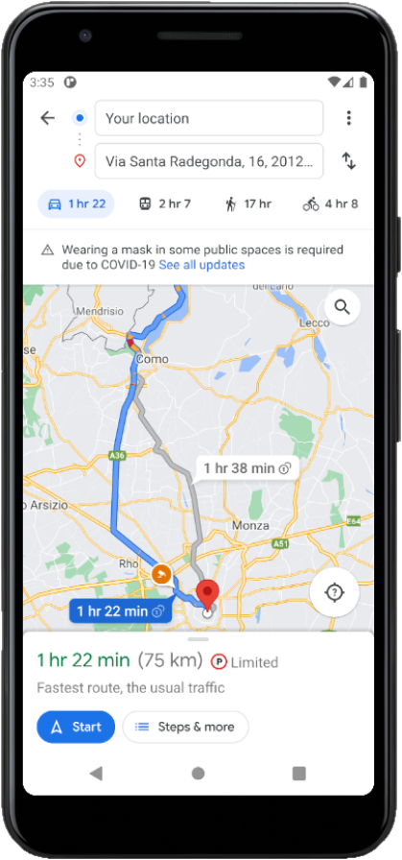
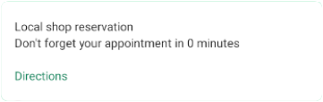
External API • MAPS
GET
https://www.google.com/maps/dir/?api=1&destination=LAT,LNG
Navigation from current location to LAT-LNG

Slide 12




Test
UI - UX
UNIT TEST
INSTRUMENTATION TEST
API 22-26-30
JUnit 4
JUnit 4
Manual, 50 h

Slide 13
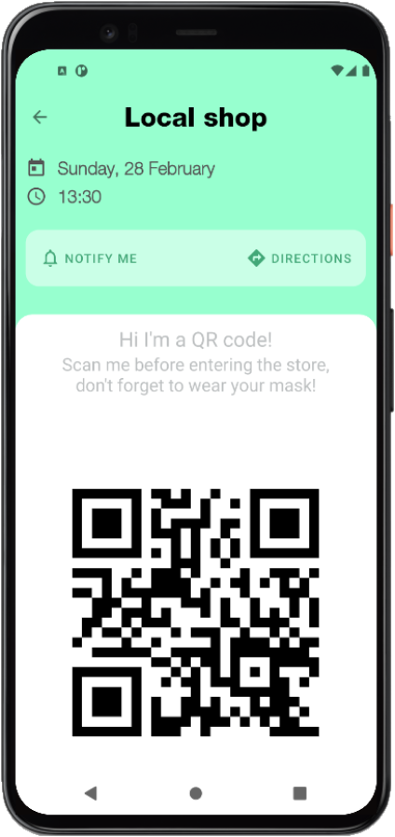
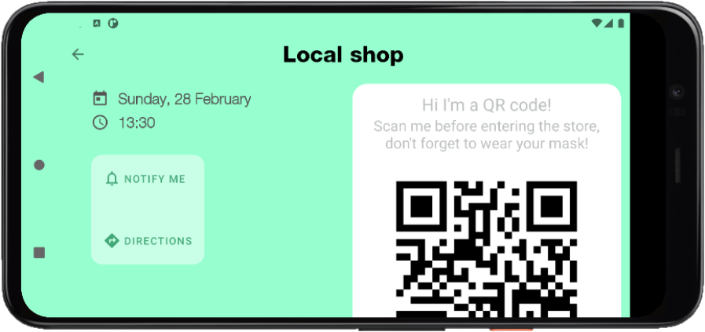








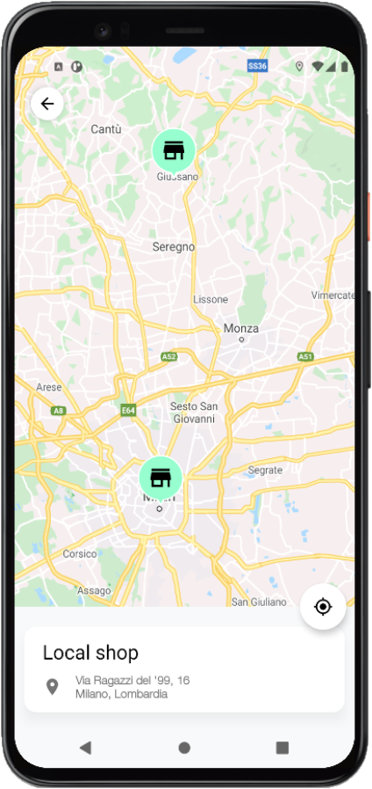
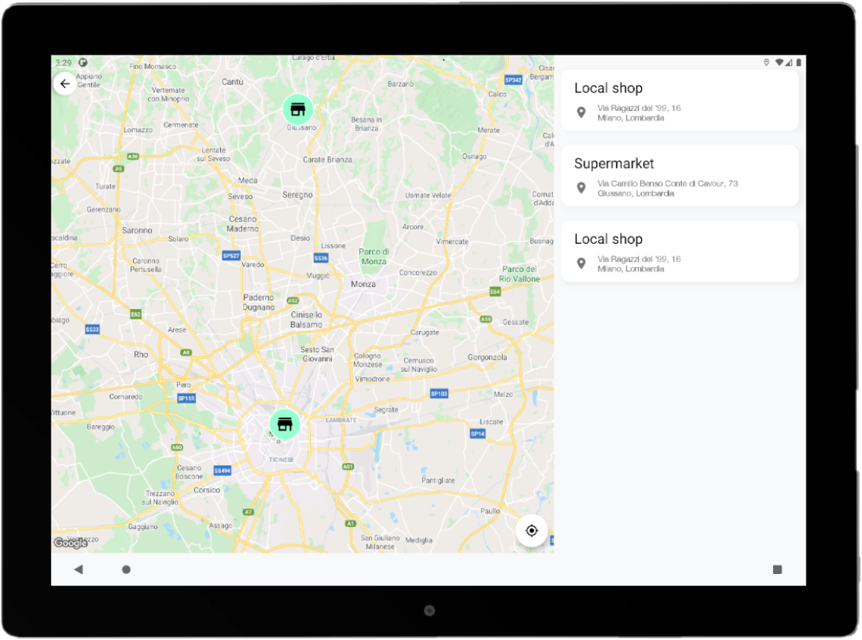

Nice to have
Landscape layout variations
AndroidX (Jetpack) framework
LiveData
Tablet layout variations
Multi language support
Dark Theme Support

Slide 14
THANKS

